Slide 1
Java Programming Unit III – Chapter 18 More Utility Classes

Slide 2
Contents
String Tokenizer
Date
Random

Slide 3
1. String Tokenizer
The String Tokenizer implements the process of Lexical Analyser (lexer or scanner)
Lexer – the first step in Parsing a String
Parsing - is the division of text into a set of discrete parts, or tokens, that conveys a semantic meaning
It uses “delimiters” to divide a string
Delimiters are characters that separate tokens

Slide 4
Constructors
StringTokenizer(String str)
str - is the string that will be tokenized
Default delimiters are used
StringTokenizer(String str, String delimiters)
str - is the string that will be tokenized
Delimiters – Specified by the program
StringTokenizer(String str, String delimiters, boolean delimAsToken)
str - is the string that will be tokenized
Delimiters – Specified by the program
delimAsToken – true: delimiters will also be tokenized.

Slide 5
Extracting Each Tokens
Using 2 functions:
hasMoreTokens()
nextToken()

Slide 6
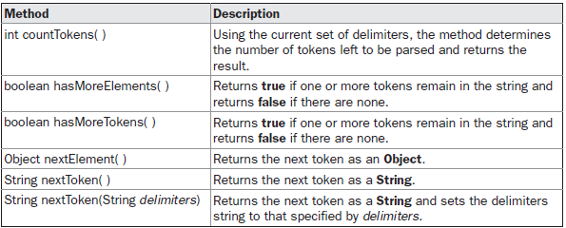
Methods in String Tokenizer

Slide 7
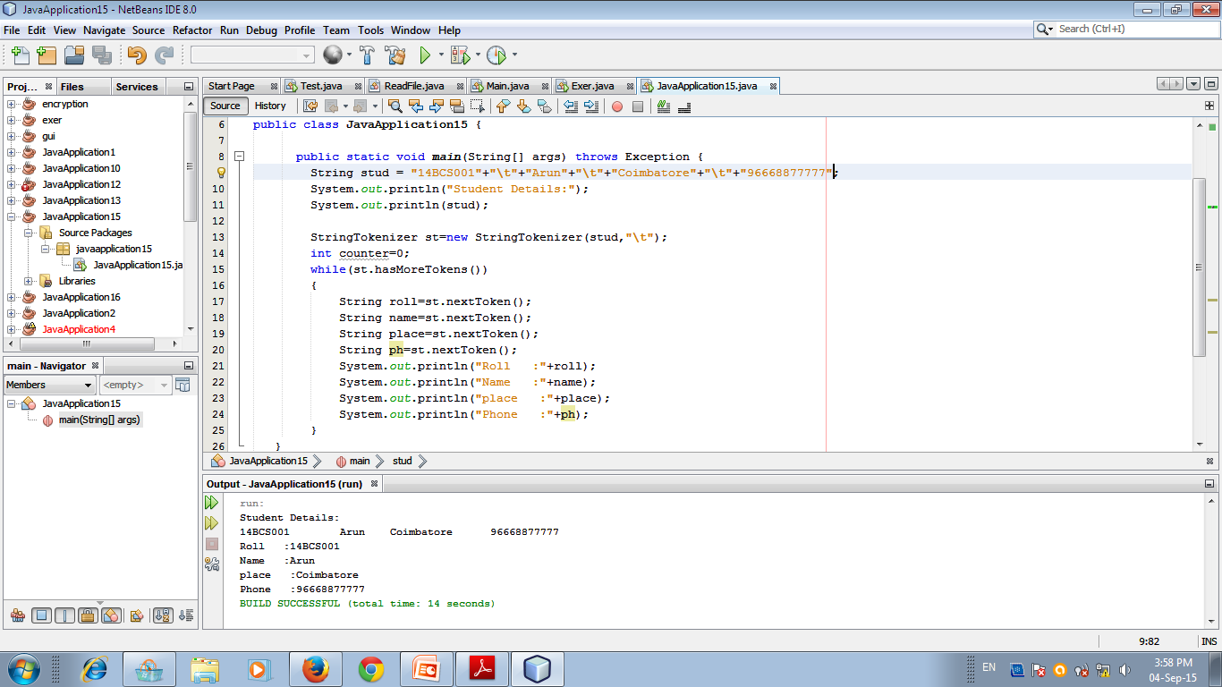

Slide 8
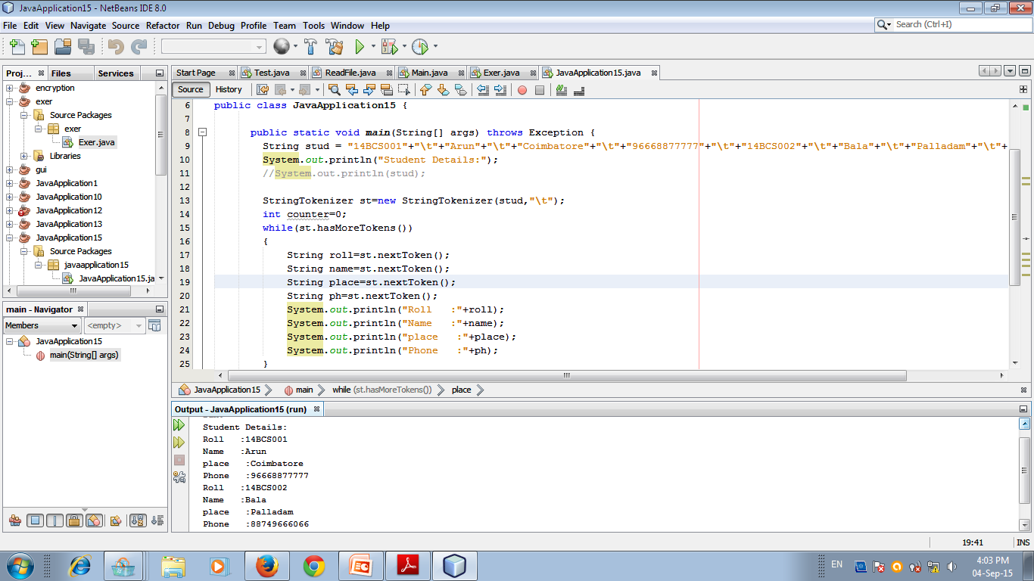

Slide 9
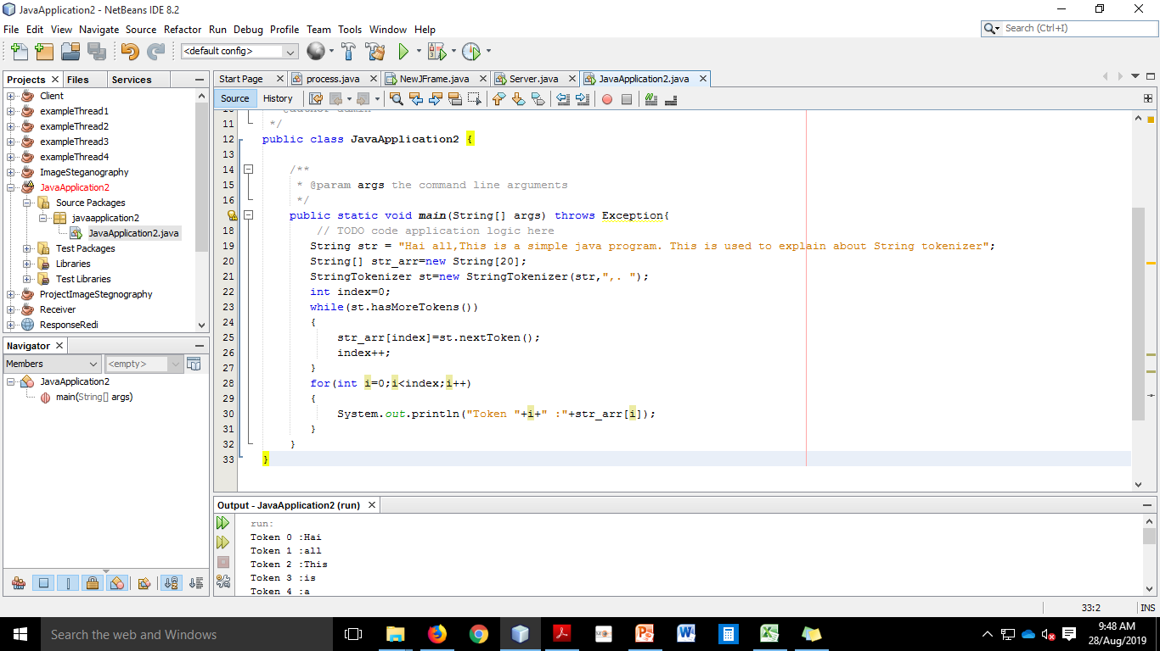
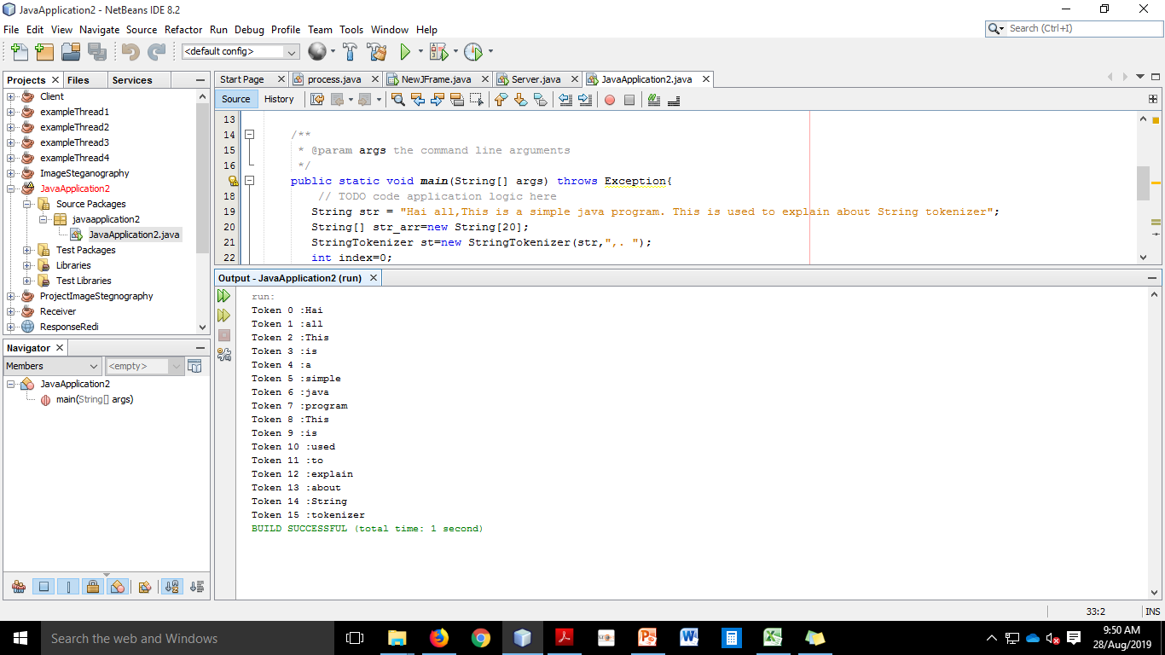

Slide 10
2. Date
Used to retrieve the current Date and Time from the system.
2 constructors:
Date()
Retrieves the current date and time and returns as an object.
Date(long millisec)
Argument → Number of milliseconds that have elapsed since midnight, January 1, 1970

Slide 11
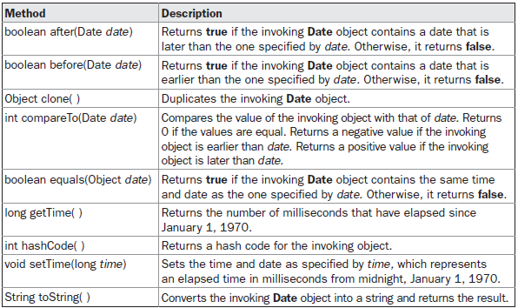
Methods...

Slide 12
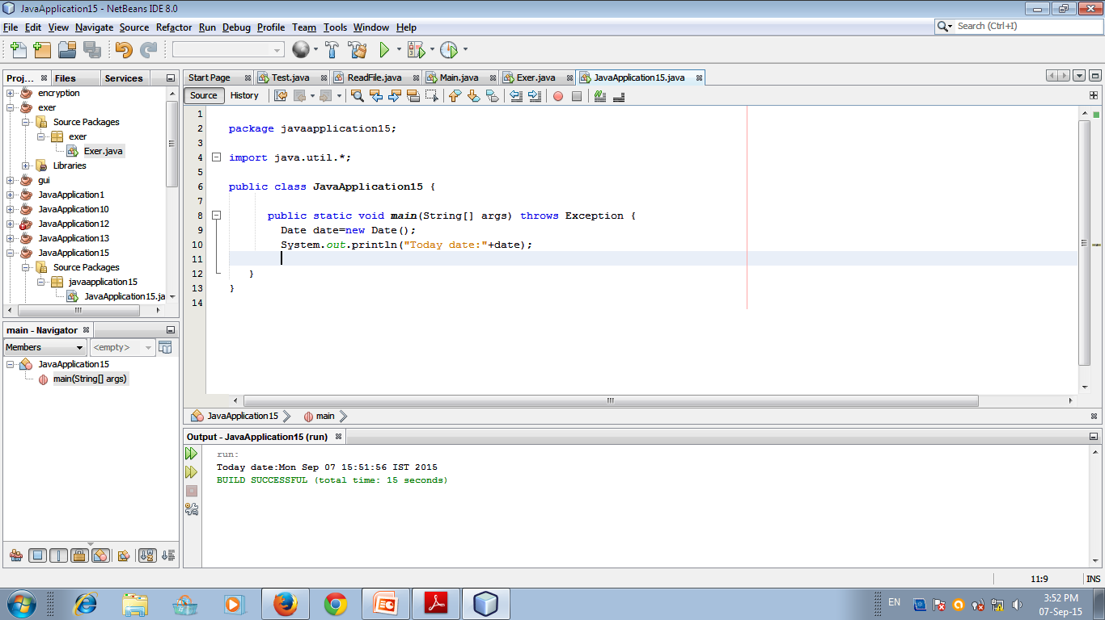

Slide 13
3) Random
The Random class is a generator of pseudorandom numbers.
2 constructors:
Random() → uses current time as the starting
Random(long seed) → uses seed as starting

Slide 14
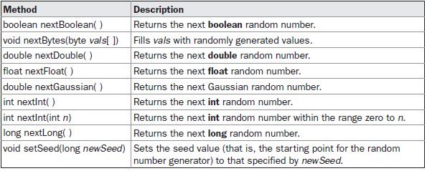
Methods…

Slide 15
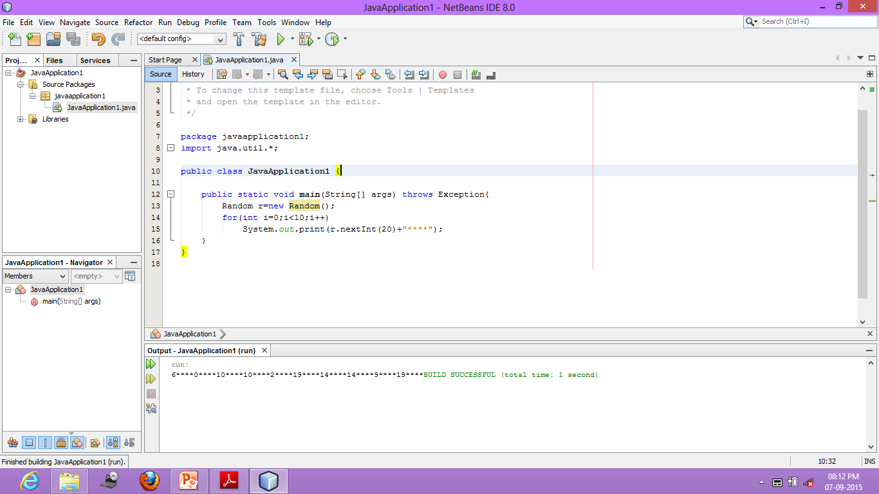

Slide 16
